Slide 1

ADM25DN002 Cruise Ship Management
Shrish Nandakumar

Slide 2
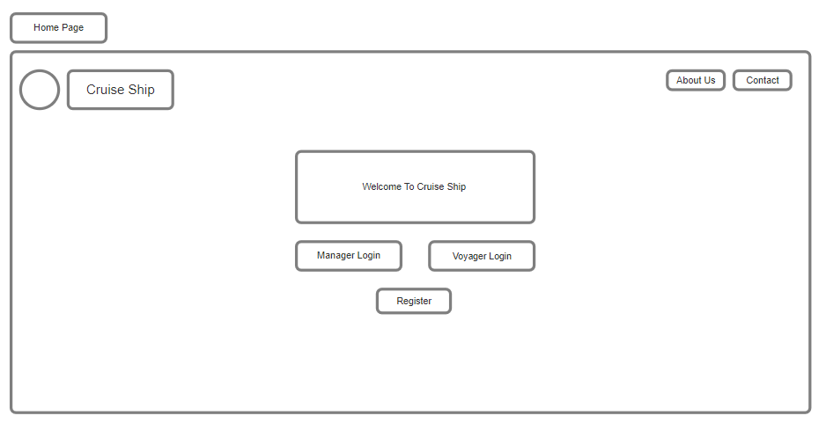
2

Slide 3
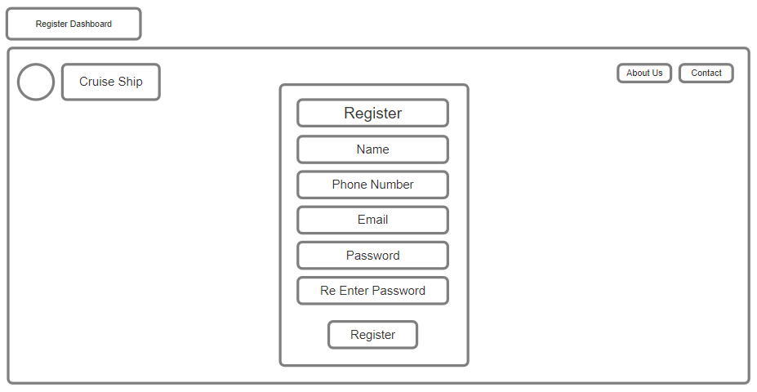
3

Slide 4
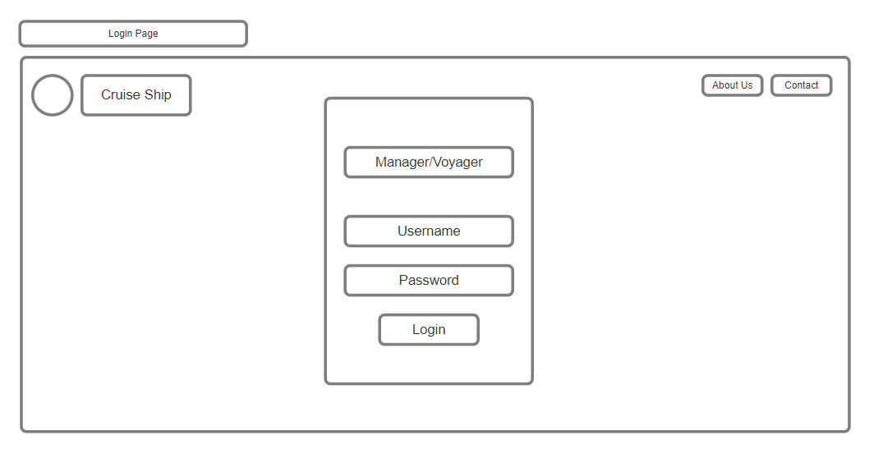
4

Slide 5
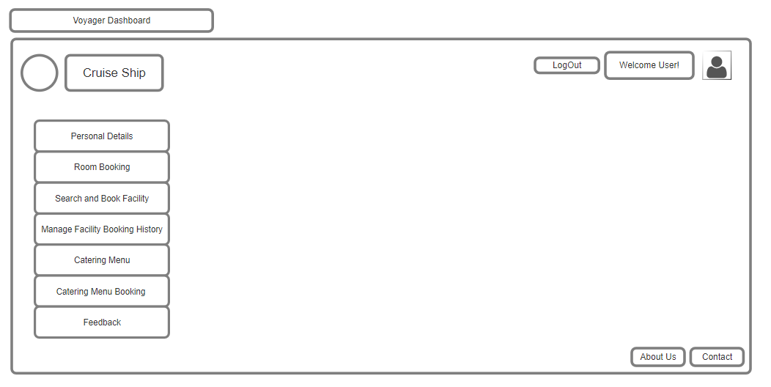
5

Slide 6
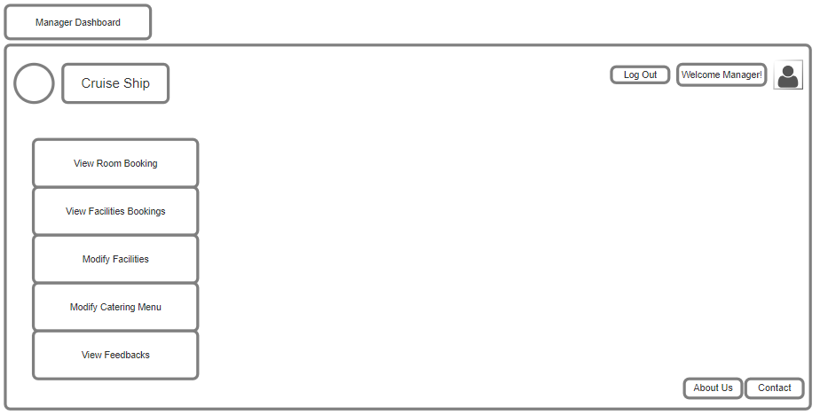
6

Slide 7
Thank You!
Shrish Nandakumar
2370018@cognizant.com

